Slide 1
I have impact on my continuous development
THROUGH ONGOING REAL-TIME FEEDBACK
WHAT DOES IT MEAN FOR ME?
Feedback Exchange tool is the main and only system that I use for Real-Time Feedback
I give my People real-time feedback so that they are able to benefit from it throughout the year
I ask my Team Members for ongoing feedback which helps me improve my leadership skills
I have direct access to my Team Members feedback and I can monitor their progress in real-time
I promote culture of continuous development
I make sure my Team Members have min. 9 feedbacks covering min. 80% of their time
Feedback is a frequent type of communication in PwC Culture, it’s a part of our Values; in PwC we encourage giving and asking for feedback to improve ourselves and others.

Slide 2
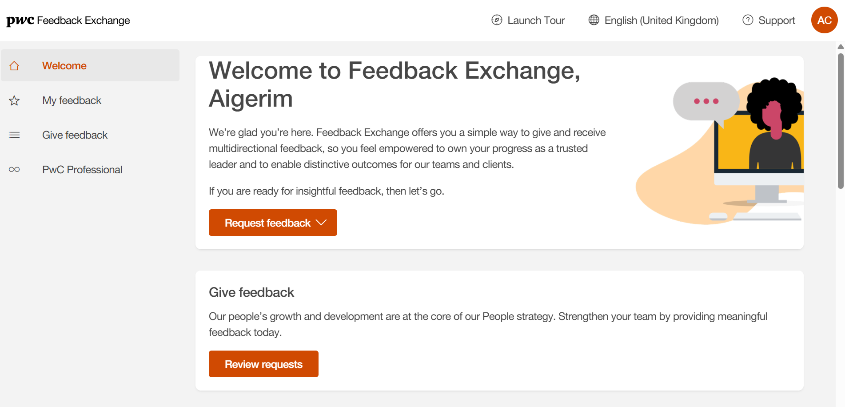
Feedback Exchange tool Technology supporting real-time feedback culture
Feedback Exchange is a global application for giving and receiving downward, peer, upward and anonymous feedback within one easy-to-use tool.
Feedback Exchange is grounded in the evolved PwC Professional framework. It allows you to have clearer insight into how you bring the PwC Professional behaviors to life and understand the value you create and where you can take action to enhance your growth.
Feedback Exchange helps provide a balanced view of both ‘what’ we do (outcomes) as well as ‘how’ we do them (behaviors).
Performance is evaluated by assessing demonstration of PwC Professional behaviours, application of knowledge and technical skills, target metrics and compliance requirements (captured through feedback tool).
Feedback Exchange tool should always be filled out during or after a feedback conversation and should never replace a conversation
Feedback Exchange tool Login

Slide 3

Introducing Feedback Exchange
Feedback Exchange is our multi-directional feedback technology that enables each of us to gain deeper insight into how our behaviour influences those around us and the overall value we create.
Watch the video here

Slide 4
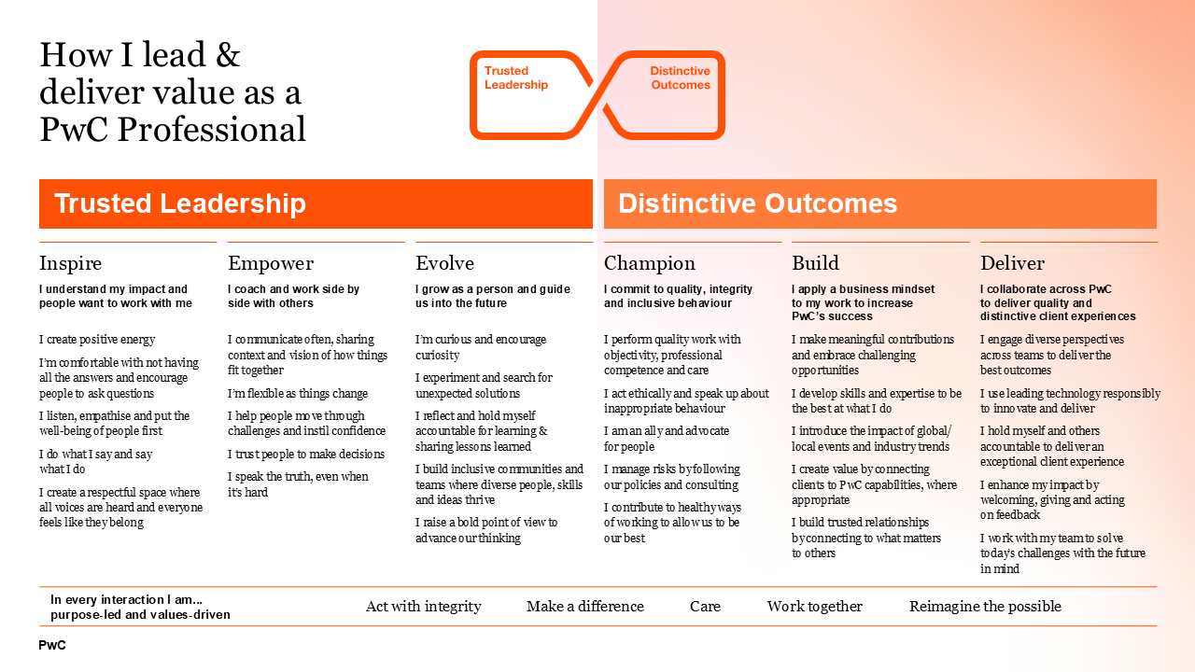
How we bring our culture to life: The PwC Professional

Slide 5

Multi-directional feedback questions in Feedback Exchange
When employee requests feedback, the feedback giver will be prompted to respond to the following questions in order to assess how the employee demonstrated PwC Professional behaviours, role expectations, and Assurance Quality Dimensions (where applicable).
Work Context
Assessing evolved PwC Professional Behaviours
Assurance Quality Dimension (AQDs)
Assessing Role Expectations
Additional Comments
Downward & peer feedback
All directions of feedback
Downward-only (opt in)
Downward-only
All directions (upward optional)
Question prompt
Reflecting on the role this individual held on this piece of work, please provide additional details on how you worked together (e.g., frequency of interaction, specific roles, complexity of effort)
Thinking about the behaviours under <Core Behaviour>, this person:
*Multiple-choice selection*
Thinking about <Assurance Quality Dimension>, this person performed:
*Multiple-choice selection*
Thinking about the role they performed, this person demonstrated knowledge and technical skills that were:
*Multiple-choice selection*
Please provide additional comments (e.g., context for responses above)
Intent of the question
Captures how you and the feedback giver have worked together from the feedback giver’s perspective
Focus is on assessing your consistent demonstration of PwC Professional behaviours
Questions emphasise our commitment to delivering quality, and are based off a new global Assurance Quality Dimension framework.
This question helps you understand whether your project contributions met the expectations of your role
Space to provide additional context around questions 2 and 3

Slide 6
Multi-directional feedback questions in Feedback Exchange
Feedback Exchange is equipped to seek feedback from individuals across all worker types, grade levels and staff in all onboarded territories. The tool supports both attributable and anonymous feedback. Anonymous feedback is released in increments of 3 -- that is, only when a batch threshold of ‘3’ pieces of feedback have been completed. This releases the feedback to the requester and their team, and it resets the anonymous batch threshold again.
Question(s) | Downward | Peer | Upward
Users can override the default direction of feedback determined by their grade, if there is a more appropriate direction based on their working relationship. | Feedback from a person operating in a more ‘senior’ capacity from you | Feedback from a person operating as a ‘peer’ | Feedback from a person operating in a more ‘junior’ capacity from you
 | Attributable | Attributable | Anonymous
Work context | ✔ | ✔ | x
PwC Professional behaviours | ✔ | ✔ | ✔
Assurance Quality Dimensions | ✔ (Assurance work, opt in only) | x | x
Role expectations | ✔ | x | x
Additional comments | ✔ | ✔ | ✔ (optional)

Slide 7
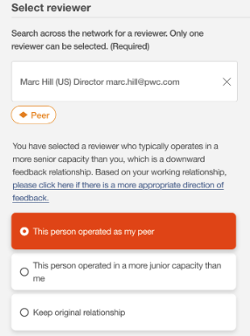
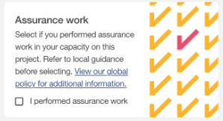
Key things to know about requesting feedback
Feedback Exchange has been designed to be user-friendly, so users shouldn’t require detailed guidance. However, here are a few key tips to keep in mind:
Introduction | Key things to know | Question overview | Response overview
This page is designed for territories who have opted in to having a finance feed of project data.
Note: if your territory has opted out, delete this slide.
Selecting a feedback direction: The system determines the feedback direction (peer, upward, or downward) by default based on grade level. However, you can easily override the default direction, if there is a more appropriate direction based on your working relationship.
Identifying Assurance work: For downward feedback, selecting “I performed assurance work” will prompt the feedback provider to respond to the series of questions related to the Assurance Quality Dimensions (AQDs) Framework.
For more detailed step-by-step instructions and a demo on creating a feedback request, refer to the Requesting Multi-Directional Feedback QRC.
Notes:
Again, before changing direction, before any assignment roles and responsibilities should be discussed and agreed

Slide 8
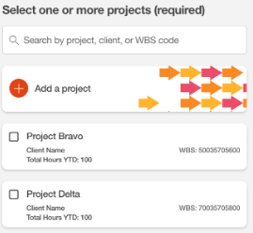

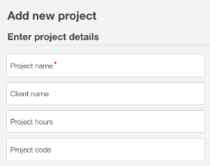
Key things to know about requesting feedback
Feedback Exchange has been designed to be user-friendly, so users shouldn’t require detailed guidance. However, here are a few key tips to keep in mind:
Introduction | Key things to know | Question overview | Response overview
Selecting a project: For downward feedback, projects where you have charged time will auto-populate. Select the project you want to receive feedback against.
You will also have the option to manually Add a Project (e.g. if you want to receive feedback for an internal project not distinctly captured in your project data).
Hours charged to a project will show as a reference point but do not need to be allocated to individual feedback requests. You can request multiple pieces of feedback against the same project.
Selecting a project: For downward feedback, you will need to manually Add a Project to capture project or role details as context for the request.
Although you will also see the option to "Select" a project from a list, please note that this feature is not active in our territory. It is a system functionality used in other parts of the network.
When manually creating your project, Project name is the only mandatory field. The other details are optional to complete if you believe they would be helpful for the feedback provider.
You can request multiple pieces of feedback against the same project.
For more detailed step-by-step instructions and a demo on creating a feedback request, refer to the Requesting Multi-Directional Feedback QRC.

Slide 9
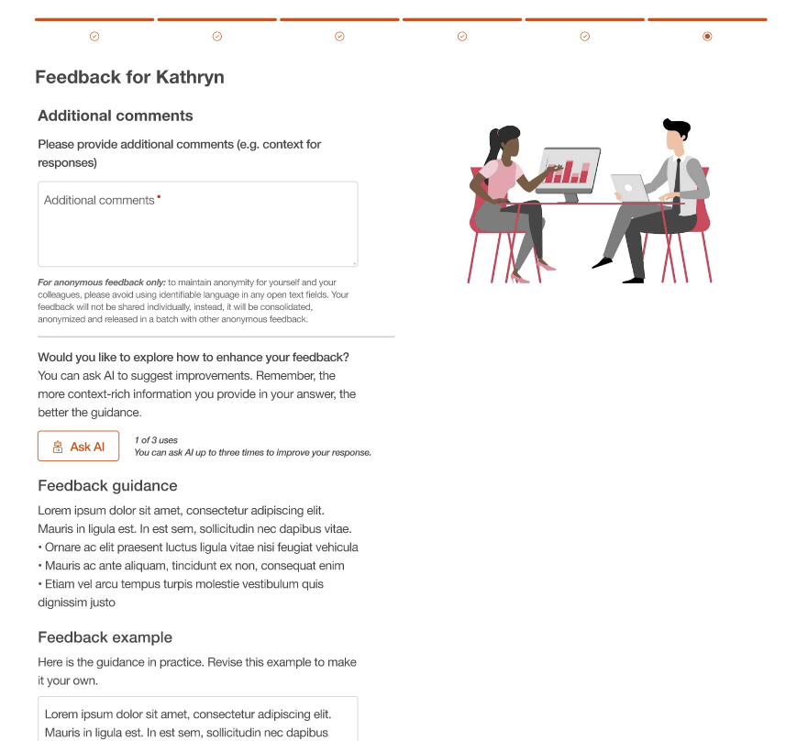
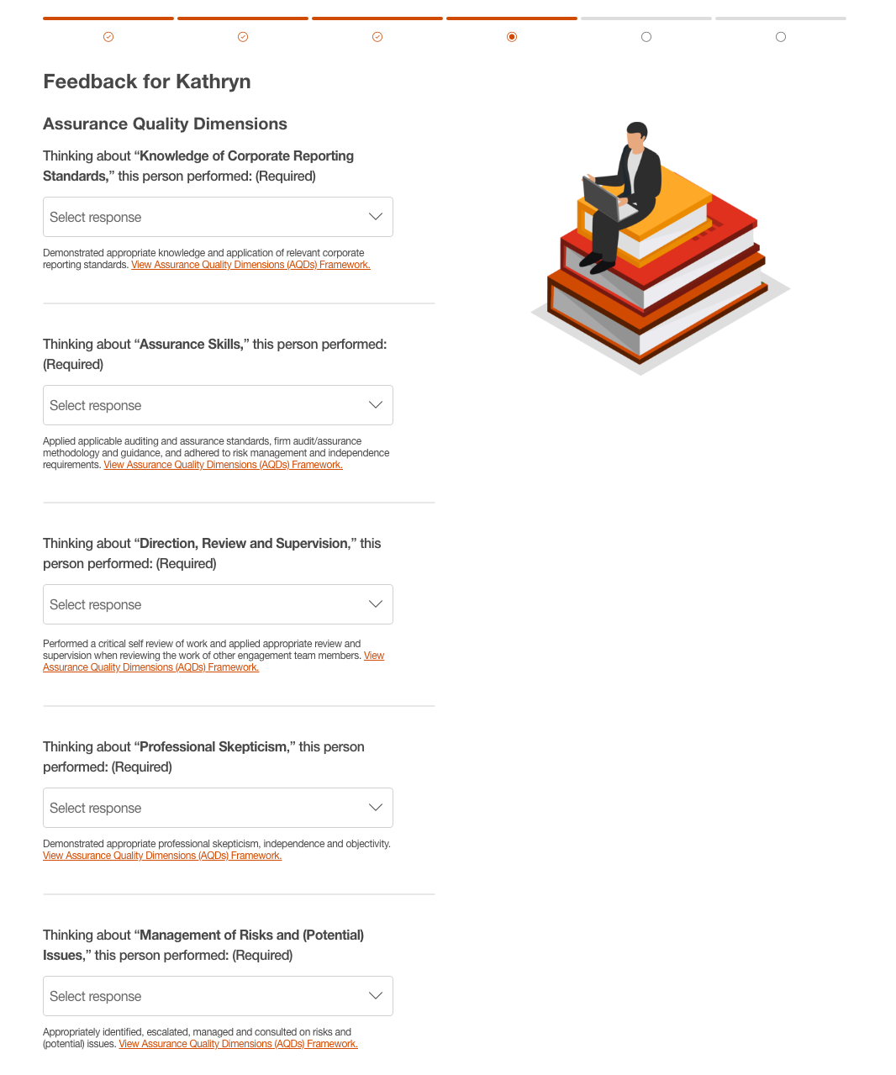
Key things to know about giving feedback
Feedback Exchange has been designed to be user-friendly, so users shouldn’t require detailed guidance. However, here are a few key tips to keep in mind:
Introduction | Key things to know | Question overview | Response overview
Writing additional comments for anonymous feedback: To maintain anonymity for yourself and your colleagues, please avoid using identifiable language in any free text fields. Your feedback will not be shared individually, instead, it will be consolidated, anonymised and released in a batch with other anonymous feedback.
Ask AI: The Ask AI feature is a supporting GenAI resource available on the Additional comments page. It provides you with optional guidance and sample text on how to improve your written feedback.
Responding to Assurance Quality Dimensions: For downward feedback only, if a requester indicated they performed Assurance work, the feedback giver will be prompted to respond to 5 questions based on the Assurance Quality Dimensions (AQDs) Framework.
For more detailed step-by-step instructions and a demo on giving feedback, refer to the Giving Multi-Directional Feedback QRC.

Slide 10
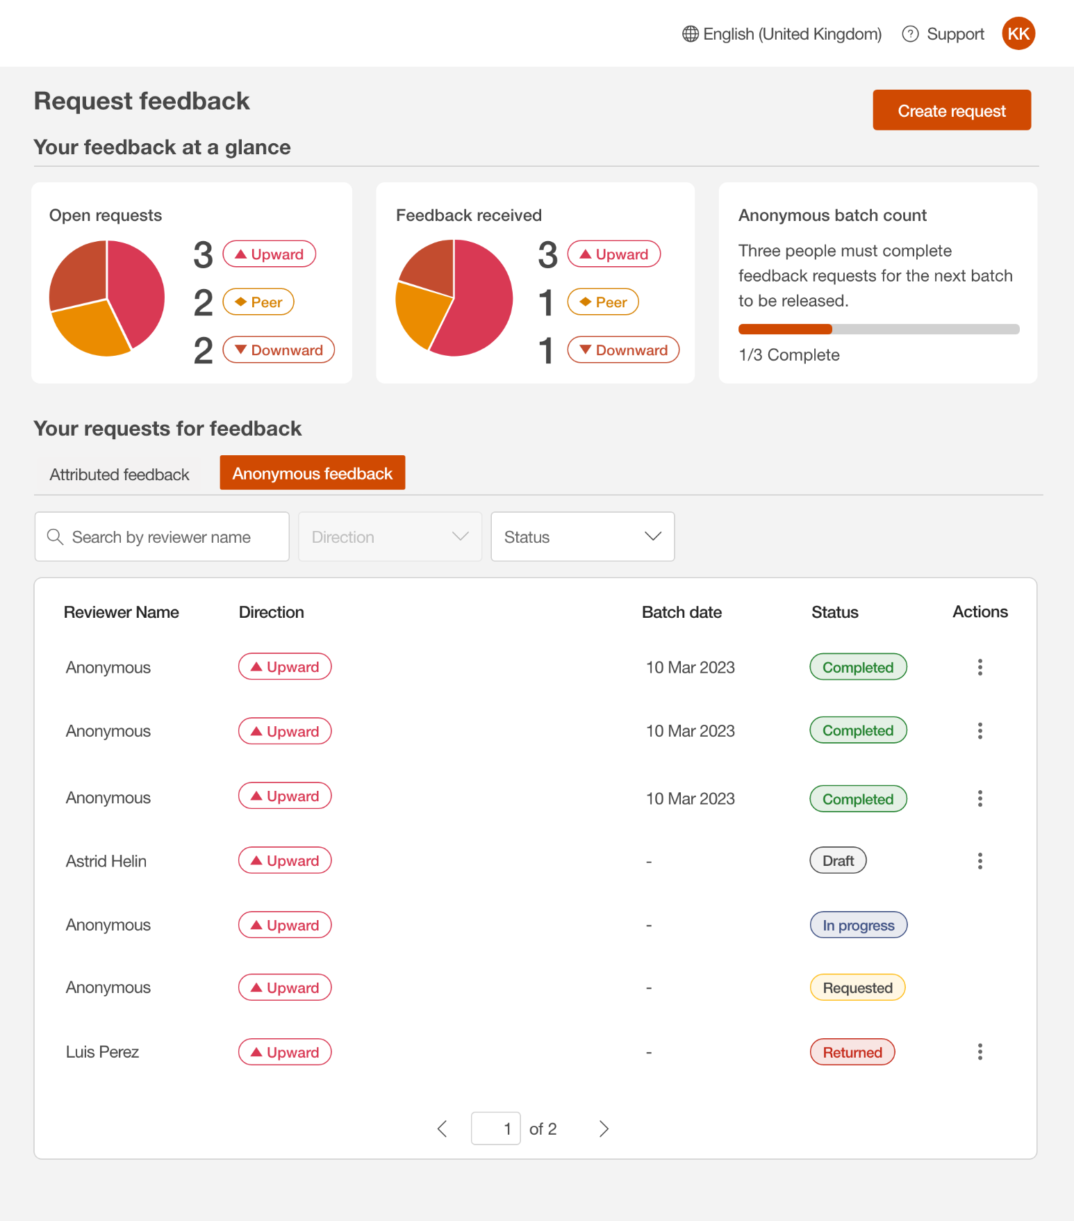
Key things to know about managing & viewing feedback
Feedback Exchange has been designed to be user-friendly, so users shouldn’t require detailed guidance. However, here are a few key tips to keep in mind:
Introduction | Key things to know | Question overview | Response overview
Viewing upward feedback: Upward (anonymous) feedback is not immediately available to view unless a minimum threshold has been met. It is made visible to the requester (and their Team Leader / Career Coach) in batches of three completed requests. Once a batch is visible, the threshold resets (i.e. another three must be completed to be visible).
Understanding feedback status
Editing feedback: Once feedback is “Completed”, no edits can be made. If feedback is “Requested” or “In progress”, work with the provider to have the request sent back for edits.
Status | Definition
Draft | Editing mode until requester saves draft and requests feedback
Requested | Requester has submitted a feedback request, changing it from Draft to Requested
Returned | Provider has returned the request for editing by the requester (e.g. if the wrong project was selected or the individual does not believe they are in a position to complete the feedback)
In Progress | Provider has viewed the request and may be editing their responses
Completed | Provider has submitted their response and the feedback is complete. For attributable feedback, Completed responses are immediately viewable. For anonymous feedback, Completed responses are released in increments of 3 (only when a batch threshold of ‘3’ individual pieces of feedback have been completed).
For more detailed step-by-step instructions and a demo on managing and viewing feedback requests, refer to the Viewing Multi-Directional Feedback QRC.

Slide 11
Understanding Likert scale for assessing PwC Professional behaviours
When you give feedback on PwC Professional behaviours, consider the following guidance on how often you should select each response. We can only grow as an organisation by providing and discussing regular, real-time honest feedback with one another. It is important to be specific when providing feedback, acknowledging context and the environment in which work was completed.
Likert scale options
Example scenario for response selection
Exemplified and motivated others to demonstrate these behaviours
Almost always demonstrated these behaviours
Often demonstrated these behaviours
Sometimes demonstrated these behaviours
Acted contradictory to these behaviours
Not applicable; did not have the opportunity to demonstrate these behaviours
During a difficult phase of the work, the individual remained agile and supported team members, helping the team see the ‘big picture’ and motivating them to remain flexible. They served as a trusted advisor to others on the team. As a result of their influence on others, the team emerged stronger and had a positive impact on the customer.
Un- common
During a difficult phase of the work, the individual consistently remained resilient, flexible, and efficient when adjusting to moving priorities. This helped the team meet deadlines, address challenges, and inspire confidence in all.
Expected Norm
During a difficult phase of the work the individual was flexible and agile when managing conflicting priorities most of the time, as expected of their role on the team.
When to select
During a difficult phase of the work, the individual struggled to be agile and role model flexible behaviours to the team, which sometimes impacted everyone around them.
Uncommon
During a difficult phase of the work, the individual was not supportive to the team, seemed absent, and struggled to adapt to changing demands.
You are working on a 3-month body of work with this individual. They request feedback after the first month, and you feel you need to wait another month to better observe and evaluate behaviours.

Slide 12
Understanding Likert scale for assessing role expectations (downward only)
Align with your manager / leader and broader team on role expectations and what “success” looks like. These expectations should be discussed at the beginning of the body of work and revisited throughout, as roles and responsibilities may evolve within fast changing environments. This shared understanding enables feedback givers to respond in a meaningful and relevant way, and provide deeper insights into your performance.
In support of these conversations, a manager / leader may share supplementary grade level expectations. This should not replace role-specific expectations set during initial conversations, but can help understand or clarify baseline expectations for an individual’s grade.
Likert scale options
Example scenario for selection
Beyond expectations
In line with expectations
Mostly in line with expectations
Below expectations
Following an initial conversation with their team, the individual consistently took initiative to not only apply the communicated role expectations, but to exceed outlined expectations. They contributed significantly to overall team performance, while also enhancing the performance of others.
Uncommon
Following an initial conversation with their team, the individual consistently demonstrated a strong understanding of the role and their expected contribution to the team. The individual delivered quality work, in line with the expectations of our high performance culture, which enabled timely delivery.
Expected Norm
When to select
Following an initial conversation with their team, the individual performed as expected most of the time but required some reminders of set expectations. The individual delivered work that was of the expected quality, but not within the expected timelines, causing disruption to overall delivery.
Uncommon
Despite multiple conversations around what is expected of someone in the role, the individual consistently missed the communicated standards, and showed limited signs of improvement. Additional time was spent refining the individual’s quality of work to bring it to the expected standard creating a negative impact on overall delivery.
*Note that feedback is just one input into performance and promotion decisions, it can provide deeper insights into the value you create, supporting your ongoing performance and development conversations but does not directly correlate with year-end results.

Slide 13
Understanding Likert scale for Assurance Quality Dimensions (downward only)
Delivering quality is paramount to building trust in Assurance and across the firm. People who work on Assurance engagements need to demonstrate the skills and behaviours that underpin quality. These elements are the foundation of the Assurance Quality Dimensions (AQDs) framework. Together with the PwC Professional behaviours they provide expectations for everyone working on Assurance engagements.
Likert scale options
Example scenario for response selection
Beyond expectations
In line with expectations
Mostly in line with expectations
Below expectations
This dimension is not applicable
As Reviewer or Preparer (or both) on the engagement, the individual demonstrated awareness of the Assurance Quality Dimension framework, and applied it consistently across the scope of their work to a level that exceeded expected responsibilities. They served as a role model to others on the team in applying this Assurance Quality Dimension. As a result, the team emerged stronger and demonstrated strong quality skills and behaviours.
Un- common
As Reviewer or Preparer (or both) on the engagement, the individual demonstrated awareness of the Assurance Quality Dimension framework and applied the Assurance Quality Dimension framework consistently in line with expected responsibilities across the scope of their work.
Expected Norm
As Reviewer or Preparer (or both) on the engagement, the individual demonstrated awareness of the Assurance Quality Dimension framework and applied the Assurance Quality Dimension framework in line with expected responsibilities but not consistently across the scope of their work.
When to select
As Reviewer or Preparer (or both) on the engagement, the individual demonstrated and applied the Assurance Quality Dimension framework to a level that was below expected responsibilities requiring additional follow-up by either themselves or a team member.
Uncommon
As per their expected responsibilities, the individual did not have an opportunity to demonstrate and apply this Assurance Quality Dimension.

Slide 14
FAQ
https://polpwc.sharepoint.com/:w:/r/sites/KZ-SD-0AA8R2Y_CZIlyUk9PVA/_layouts/15/Doc.aspx?sourcedoc=%7B64D02201-DA99-4B1E-A27B-0A9C7EF83FBF%7D&file=Feedback%20Exchange%20tool%20%20-%20FAQs.docx&action=default&mobileredirect=true

Slide 15
Self-reflection tool
The tool has been designed to support you to: Develop awareness and understanding of the behaviours expected of an PwC Professional. Engage in reflective questions about the behaviours to encourage self-awareness and drive individual growth. Gain insight into personal strengths and opportunities for growth. Prioritise which behaviours to practise and enhance with colleagues, teams and client.
https://learn.growthcentre.proedge.pwc.com/course/c7db1c5c-9ee1-4ac6-914e-406335f04c4e

Slide 16

EEC model: three steps framework for giving feedback (focus on deliverable, not a person)
E example
E effect
C continue
In this step, you describe the other person’s behavior or actions giving specific examples.
You describe the impact of that behavior on you. Where possible, give the result of this impact in terms of your own behavior or feelings.
If a change is needed, you outline a suggestion for improvement.
In action: „You have been completing your assignment in due time.”
In action: „It makes me very comfortable to know I can rely on.”
In action: „keep doing that, responsibility and discipline are your obvious strengths.”
Notes:
The EEC model provides a straightforward step by step process for giving feedback to others. This process is universal. It can be used with peers, your team leader, team members, and clients equally. The process is not judgemental, but describes behaviour which has had an impact, positive or negative. The EEC process stimulates a real conversation about a person's behaviour, and helps provide clarity about what to keep doing or what that person needs to do differently.
Describe the context, „I“ talk, avoid generalizations, judgement, have clarity about your own motives and reasons for giving feedback, Avoid „but” (it’s hidden judgment) - use “and”, check how the feedback was understood and follow up on agreed actions

Slide 17
EEC model: three steps framework for giving feedback (focus on deliverable, not a person)
E example
E effect
C change
In this step, you describe the other person’s behavior or actions giving specific examples.
You describe the impact of that behavior on you. Where possible, give the result of this impact in terms of your own behavior or feelings.
If a change is needed, you outline a suggestion for improvement.
In action: „When the meeting started, the meeting’s objective was not clear.”
In action: „The effect this had on me was I felt unfocussed, because I didn’t know where the meeting was going and was less able to make my contribution.”
In action: „In future, I suggest you explain your objective at the start of the meeting.”
Notes:
The EEC model provides a straightforward step by step process for giving feedback to others. This process is universal. It can be used with peers, your team leader, team members, and clients equally. The process is not judgemental, but describes behaviour which has had an impact, positive or negative. The EEC process stimulates a real conversation about a person's behaviour, and helps provide clarity about what to keep doing or what that person needs to do differently.
На слайде
previous feedback should not impact on current deliverable,

Slide 18

Tips for Reviewer
Feedback should be given for reviewed work only (not for the whole project)
If you want to give developmental feedback, discuss it with your reviewee first to avoid demotivating effect and provide as much constructive evidence as possible
Feedbacks should always be submitted in the system during or after a feedback conversation and should never replace a conversation.
Provide a view of both ‘what’ they do (outcomes) as well as ‘how’ they do them (behaviors).

Slide 19

Tips for Reviewee
Feedback should be requested for reviewed work only
Name the Feedback request (description of the piece of work to be reviewed), provide specific details on context, describe your role, number of hours, etc.
Request feedback on a piece of work you have recently done, to review strengths, correct behavior and check progress made. Do not always wait for the end of a project.
80% OF TIME should be covered by Feedback Exchange feedbacks (9-12 feedbacks for performance year)
Feedback should be requested for a negative experience as well
Notes:
Milestone feedbacks for long projects are critical
техническая остановка машины во время гонки для выполнения заправки топливом, смены шин, смены водителей, быстрого ремонта и проверки технического состояния машины.
A pit stop is a pause for refuelling, new tyres, repairs, mechanical adjustments, a driver change

